Slide 1

Telco Customer Churn Analysis
Understanding Customer Behaviour to Reduce Churn
Presenter : KwangSuk Sul
Git-Hub :https://github.com/KoreanBeaver
Notes:
This presentation will provide insights into churn rates and various statistics related to churn for a Telecommunication company, along with an analysis to suggest strategic solutions for reducing customer churn. If anyone is not familiar with the term Churn, it means leaving customers.

Slide 2
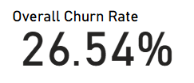
Overall Churn of Telco
Overall Churn Rate
1 customer every 4
Industry average churn rate of 20~25%
Total customers: 7043
Churn customers: 1869
Notes:
Current average churn rate is reaching 26.54% and this means every 1 customer out of 4 customers are leaving the service. This is over the industry average which is between 20 to 25%. From this data, I started my project to find out different reasons of churn customers and to reduce churn rate.

Slide 3
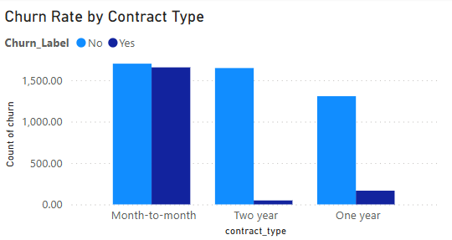
Churn Count by Contract Type
Month to Month has the highest churn numbers
Month to month - 1655
One Year – 166
Two Year – 48
Notes:
The graph here is showing total number of churn customers by contract type. According to the graph, month-to-month contract has a dramatically high possession for churn customers. This shows there are need of action to make customers to choose longer contract options.

Slide 4
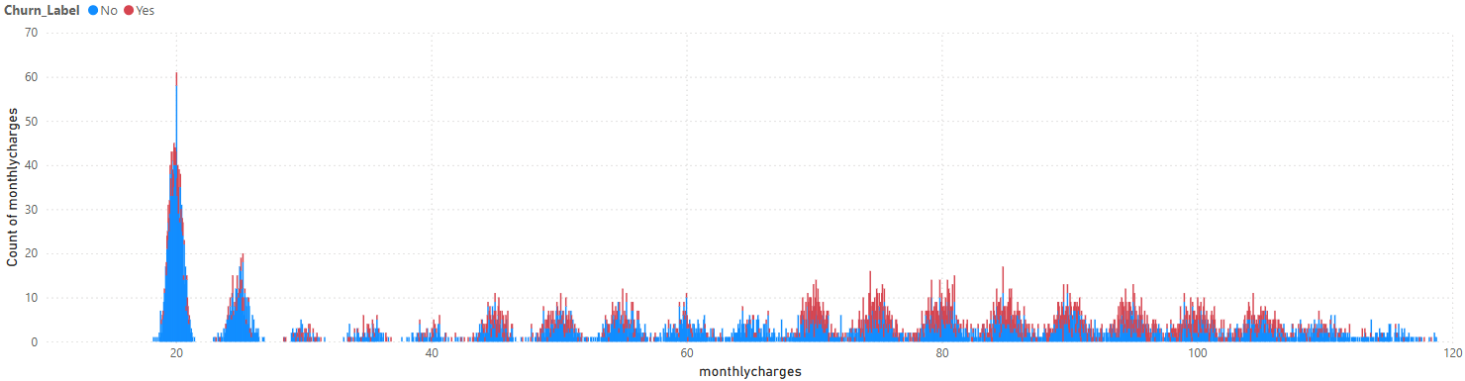
Monthly Charges Distribution by Churn
Churn customers are concentrated monthly charges between $70~$100
None churn customers are concentrated monthly charges between $20~$50
Higher price, higher chance of churn
Notes:
This graph shows in which price range of service churn customers were on more than other price range. Clearly 70~100 dollors range had highest number of churn customers. This insight promotion or discount should be taken as an option for future strategies.

Slide 5
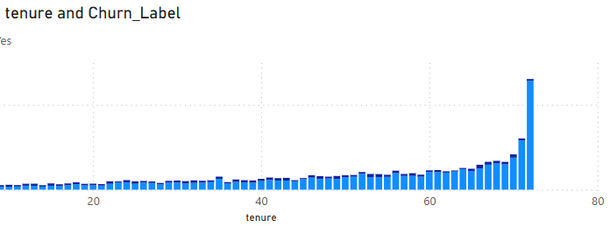
Tenure Distribution by Churn
Higher churn rate on customer less than 10 months
Experience in early stage seems important
Long term customers over 10 months has low churn rate

Slide 6
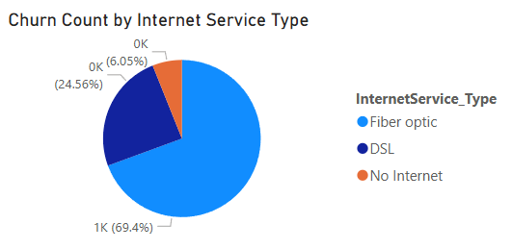
Churn Count by Internet Service Type

Slide 7
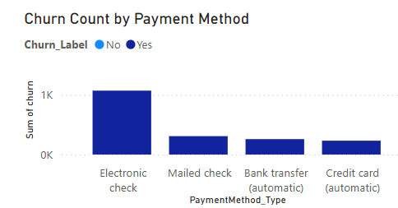

Slide 8
Future Strategies
Churn rate above industry average
Promotion or discount offer for longer term contract
Discount or Bundle options for high monthly charge products
Make sales representative for early stage customers
Lower the price for first 10 month
Give discount on credit card paying customer
Notes:
Provide long term contract benefits such as special bundle or discounted services. First 6 months to 10 months is the key. Provide focused customer service for early customers to reduce bad experiences.
CS surveys are need to expand data accuracy for churn customers for the future to reduce more.
Automated payment and discount for card payment is needed.

Slide 9
Q&A
Thank you
Notes:
I have analysed whole dataset to find possible reasons for churn customers and studied data to reach solutions to reduce churn customers for the business.

